Slide 1
Central Training And Placement Cell
Basic Programs of C++ for Campus Preparation

Slide 2
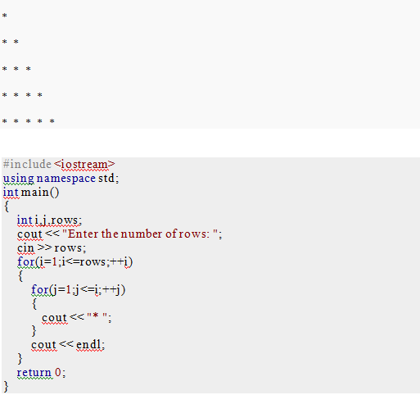
Write a C++ Program to print half pyramid as using * as shown in figure below.

Slide 3
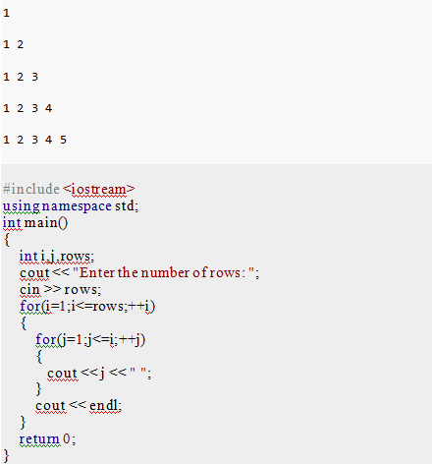
Write a C++ Program to print half pyramid as using numbers as shown in figure below.

Slide 4
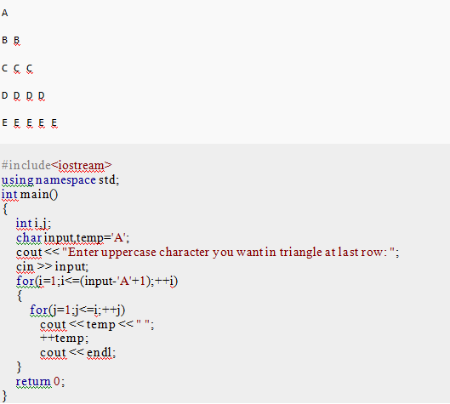
Write a C++ Program to print triangle of characters as below

Slide 5
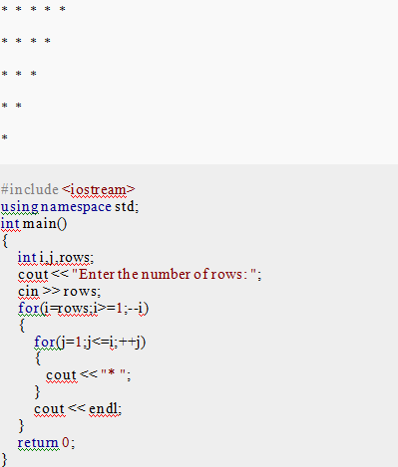
Write a C++ Program to print inverted half pyramid using * as shown below.

Slide 6
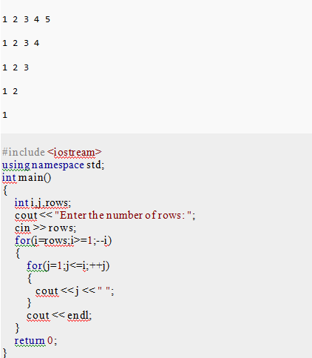
Write a C++ Program to print inverted half pyramid as using numbers as shown below.

Slide 7
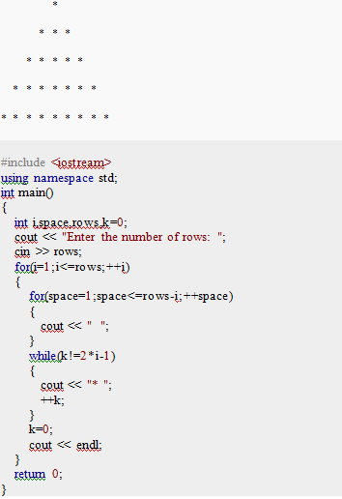
Write a C++ program to print pyramid using *

Slide 8
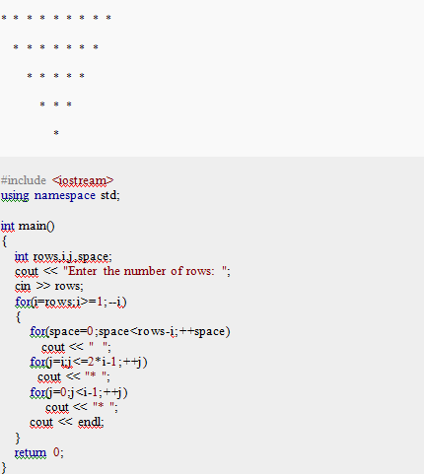
Write a C++ program to display reverse pyramid.

Slide 9
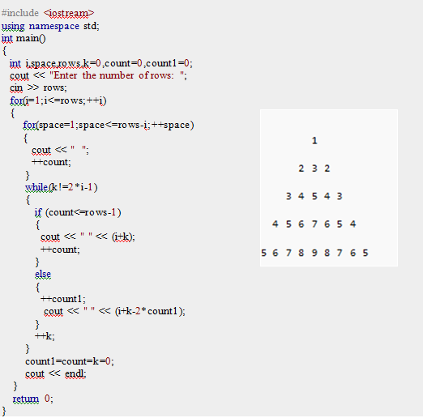
Write a C++ program to print the pyramid of digits in pattern as below.

Slide 10
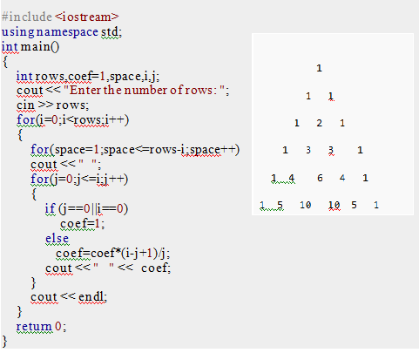
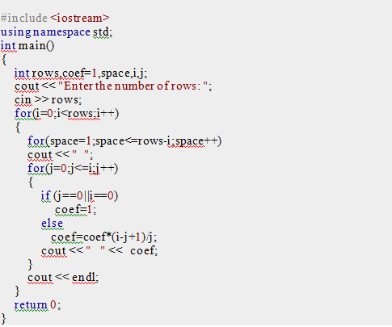
C++ Program to Draw Pascal's triangle

Slide 11
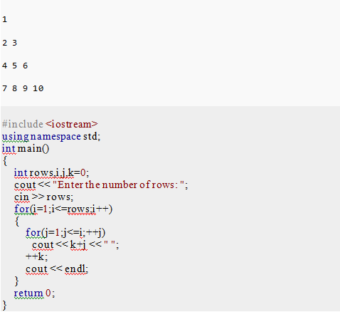
C++ Program to display Floyd's Triangle.

Slide 12
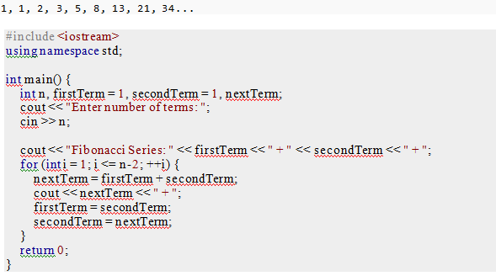
Fibonacci sequence up to nth term

Slide 13
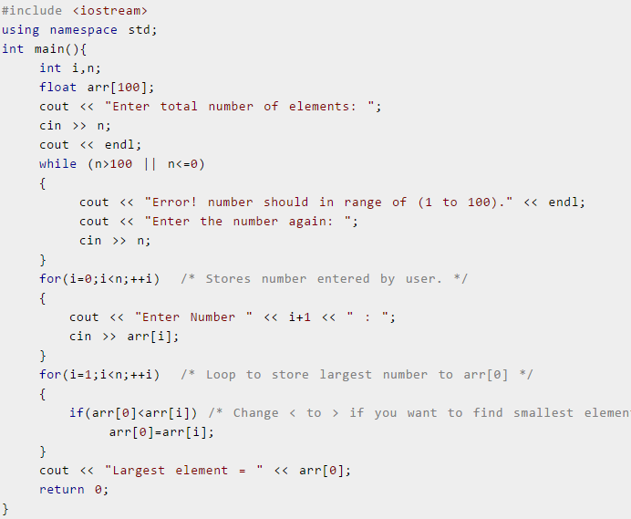
Display Largest or Smallest Element of an array

Slide 14
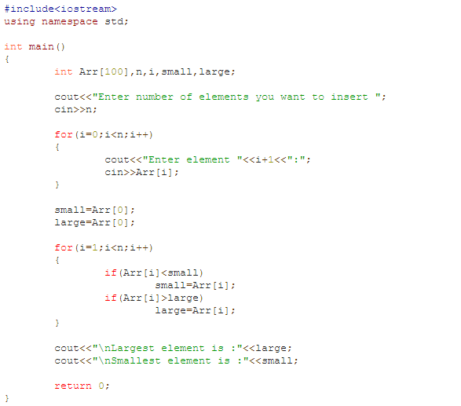

Slide 15
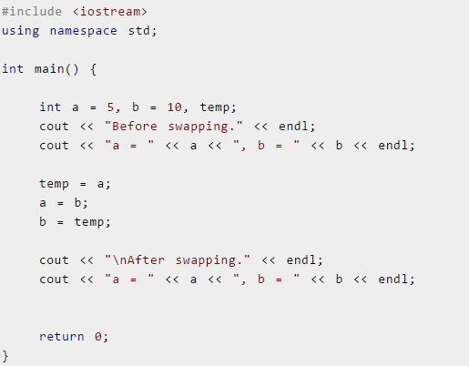
C++ Program to Swap Two Numbers , using 1 variable

Slide 16
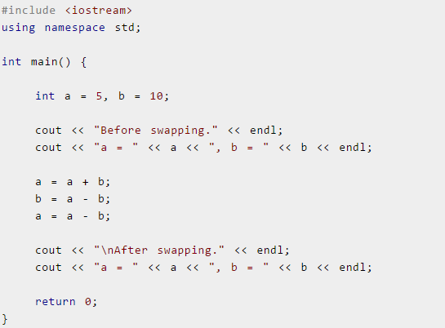
C++ Program to Swap Two Numbers , without using temporary variable

Slide 17
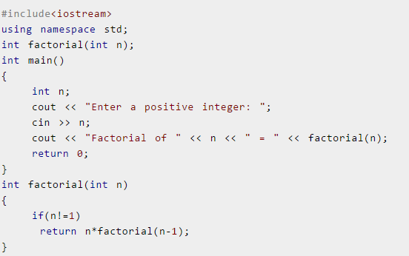
Calculate Factorial Using Recursion

Slide 18
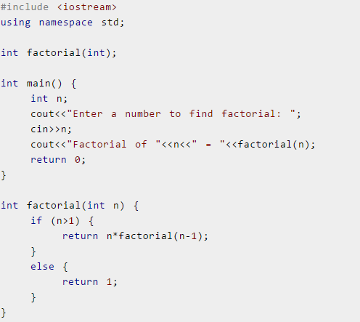
2nd approach

Slide 19
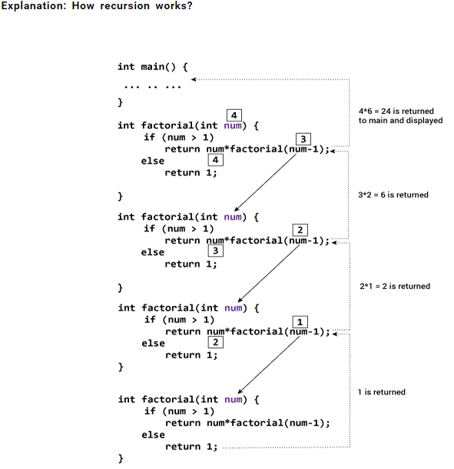

Slide 20
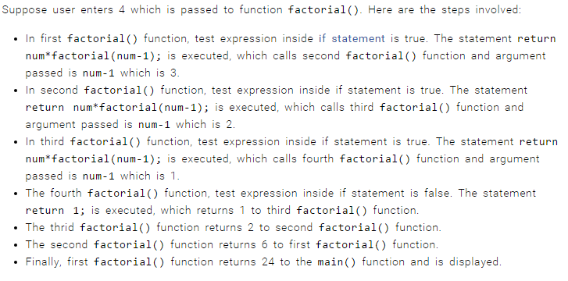
Steps Involved in factorial

Slide 21
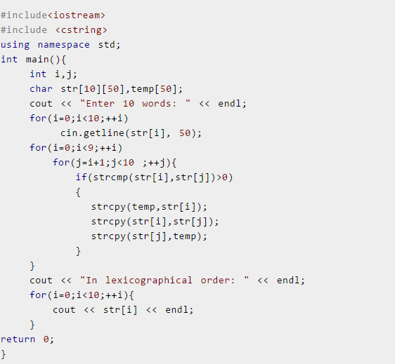
C++ Program to Sort Elements in Lexicographical Order (Dictionary Order)

